Slide 1

Enter
Dualog
Notes:
I was late for exposing another idea, so this is my Project as a one man team

Slide 2

Enter
Dualog
Notes:
I was late for exposing another idea, so this is my Project as a one man team

Slide 3
Notes:
Start with who is the objective, it is not only management

Slide 4
Notes:
Or sales

Slide 5
Notes:
But everyone and everything. There is only one think that you have to remember

Slide 6
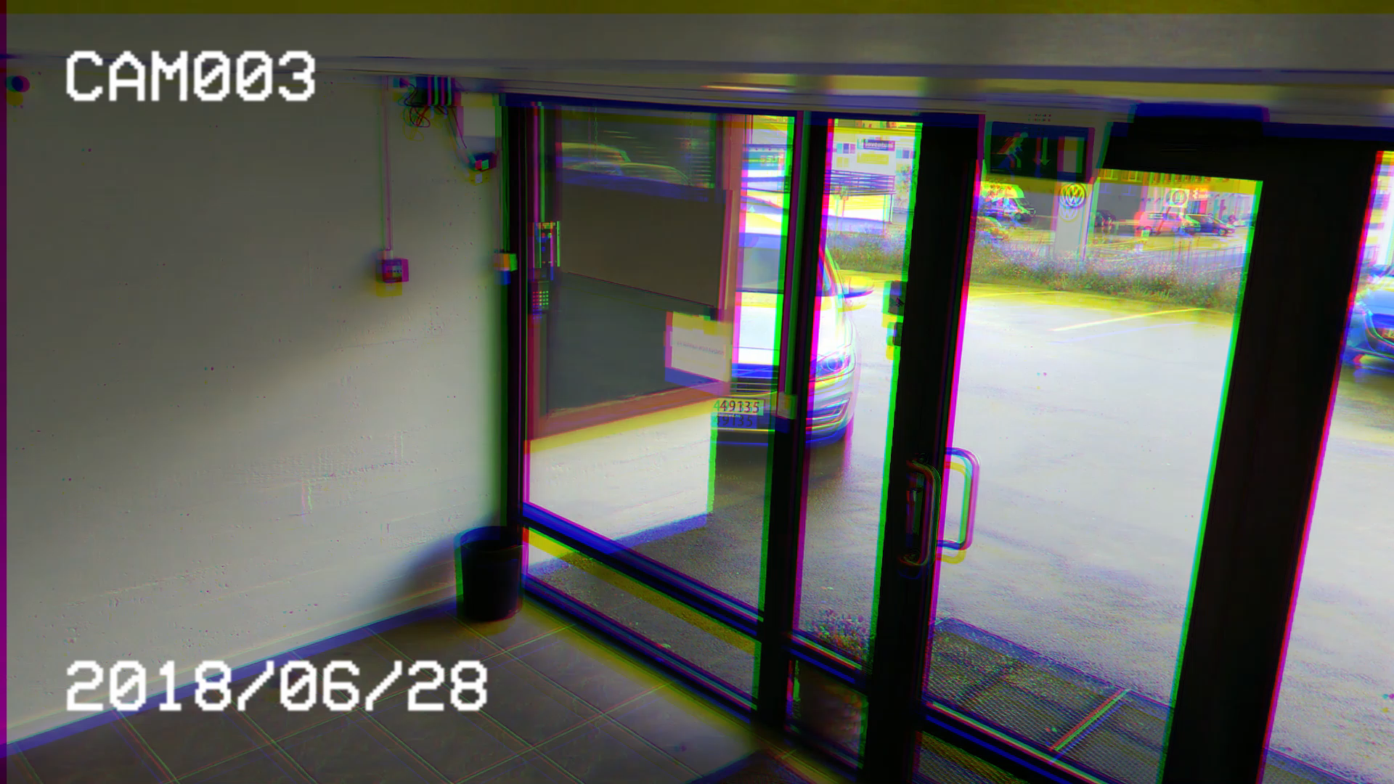

Slide 7
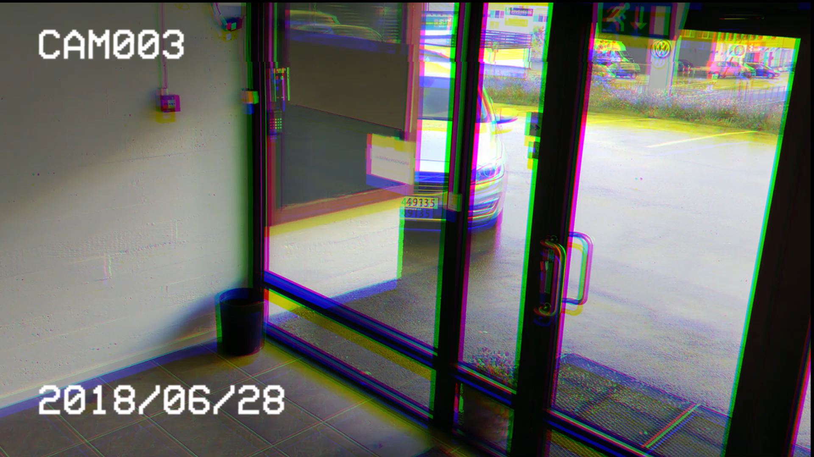
Waste of time
Annoying
Slow
Old-school
Notes:
Even when you do not forget, using a key is

Slide 8





Slide 13
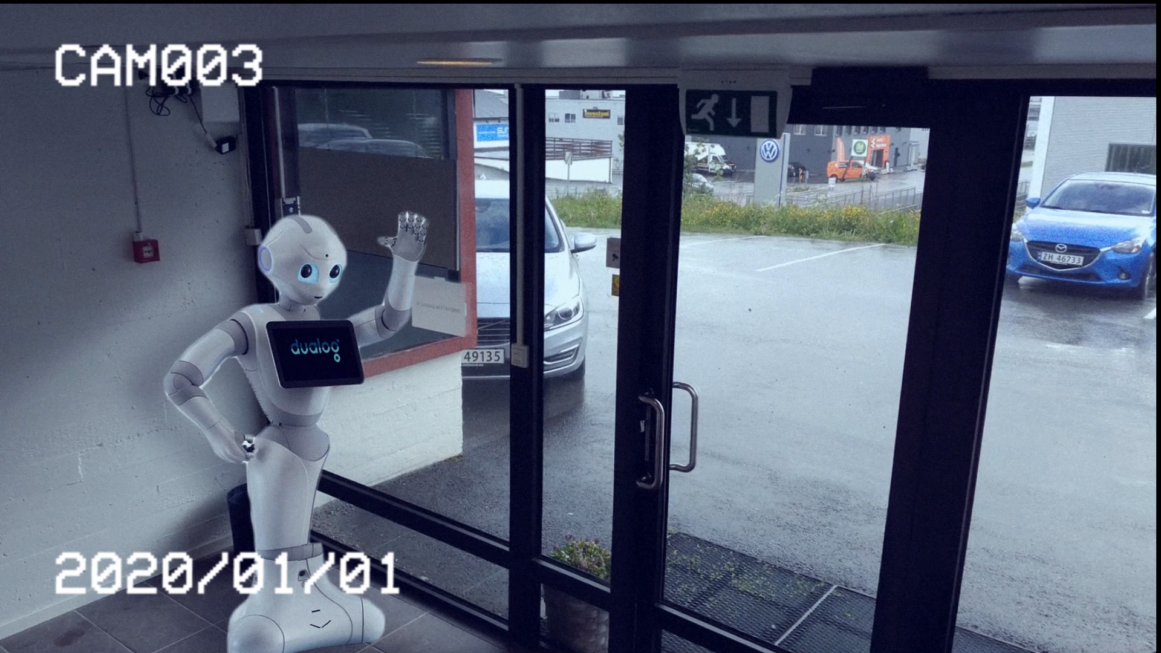

Slide 14
Solution

Slide 15
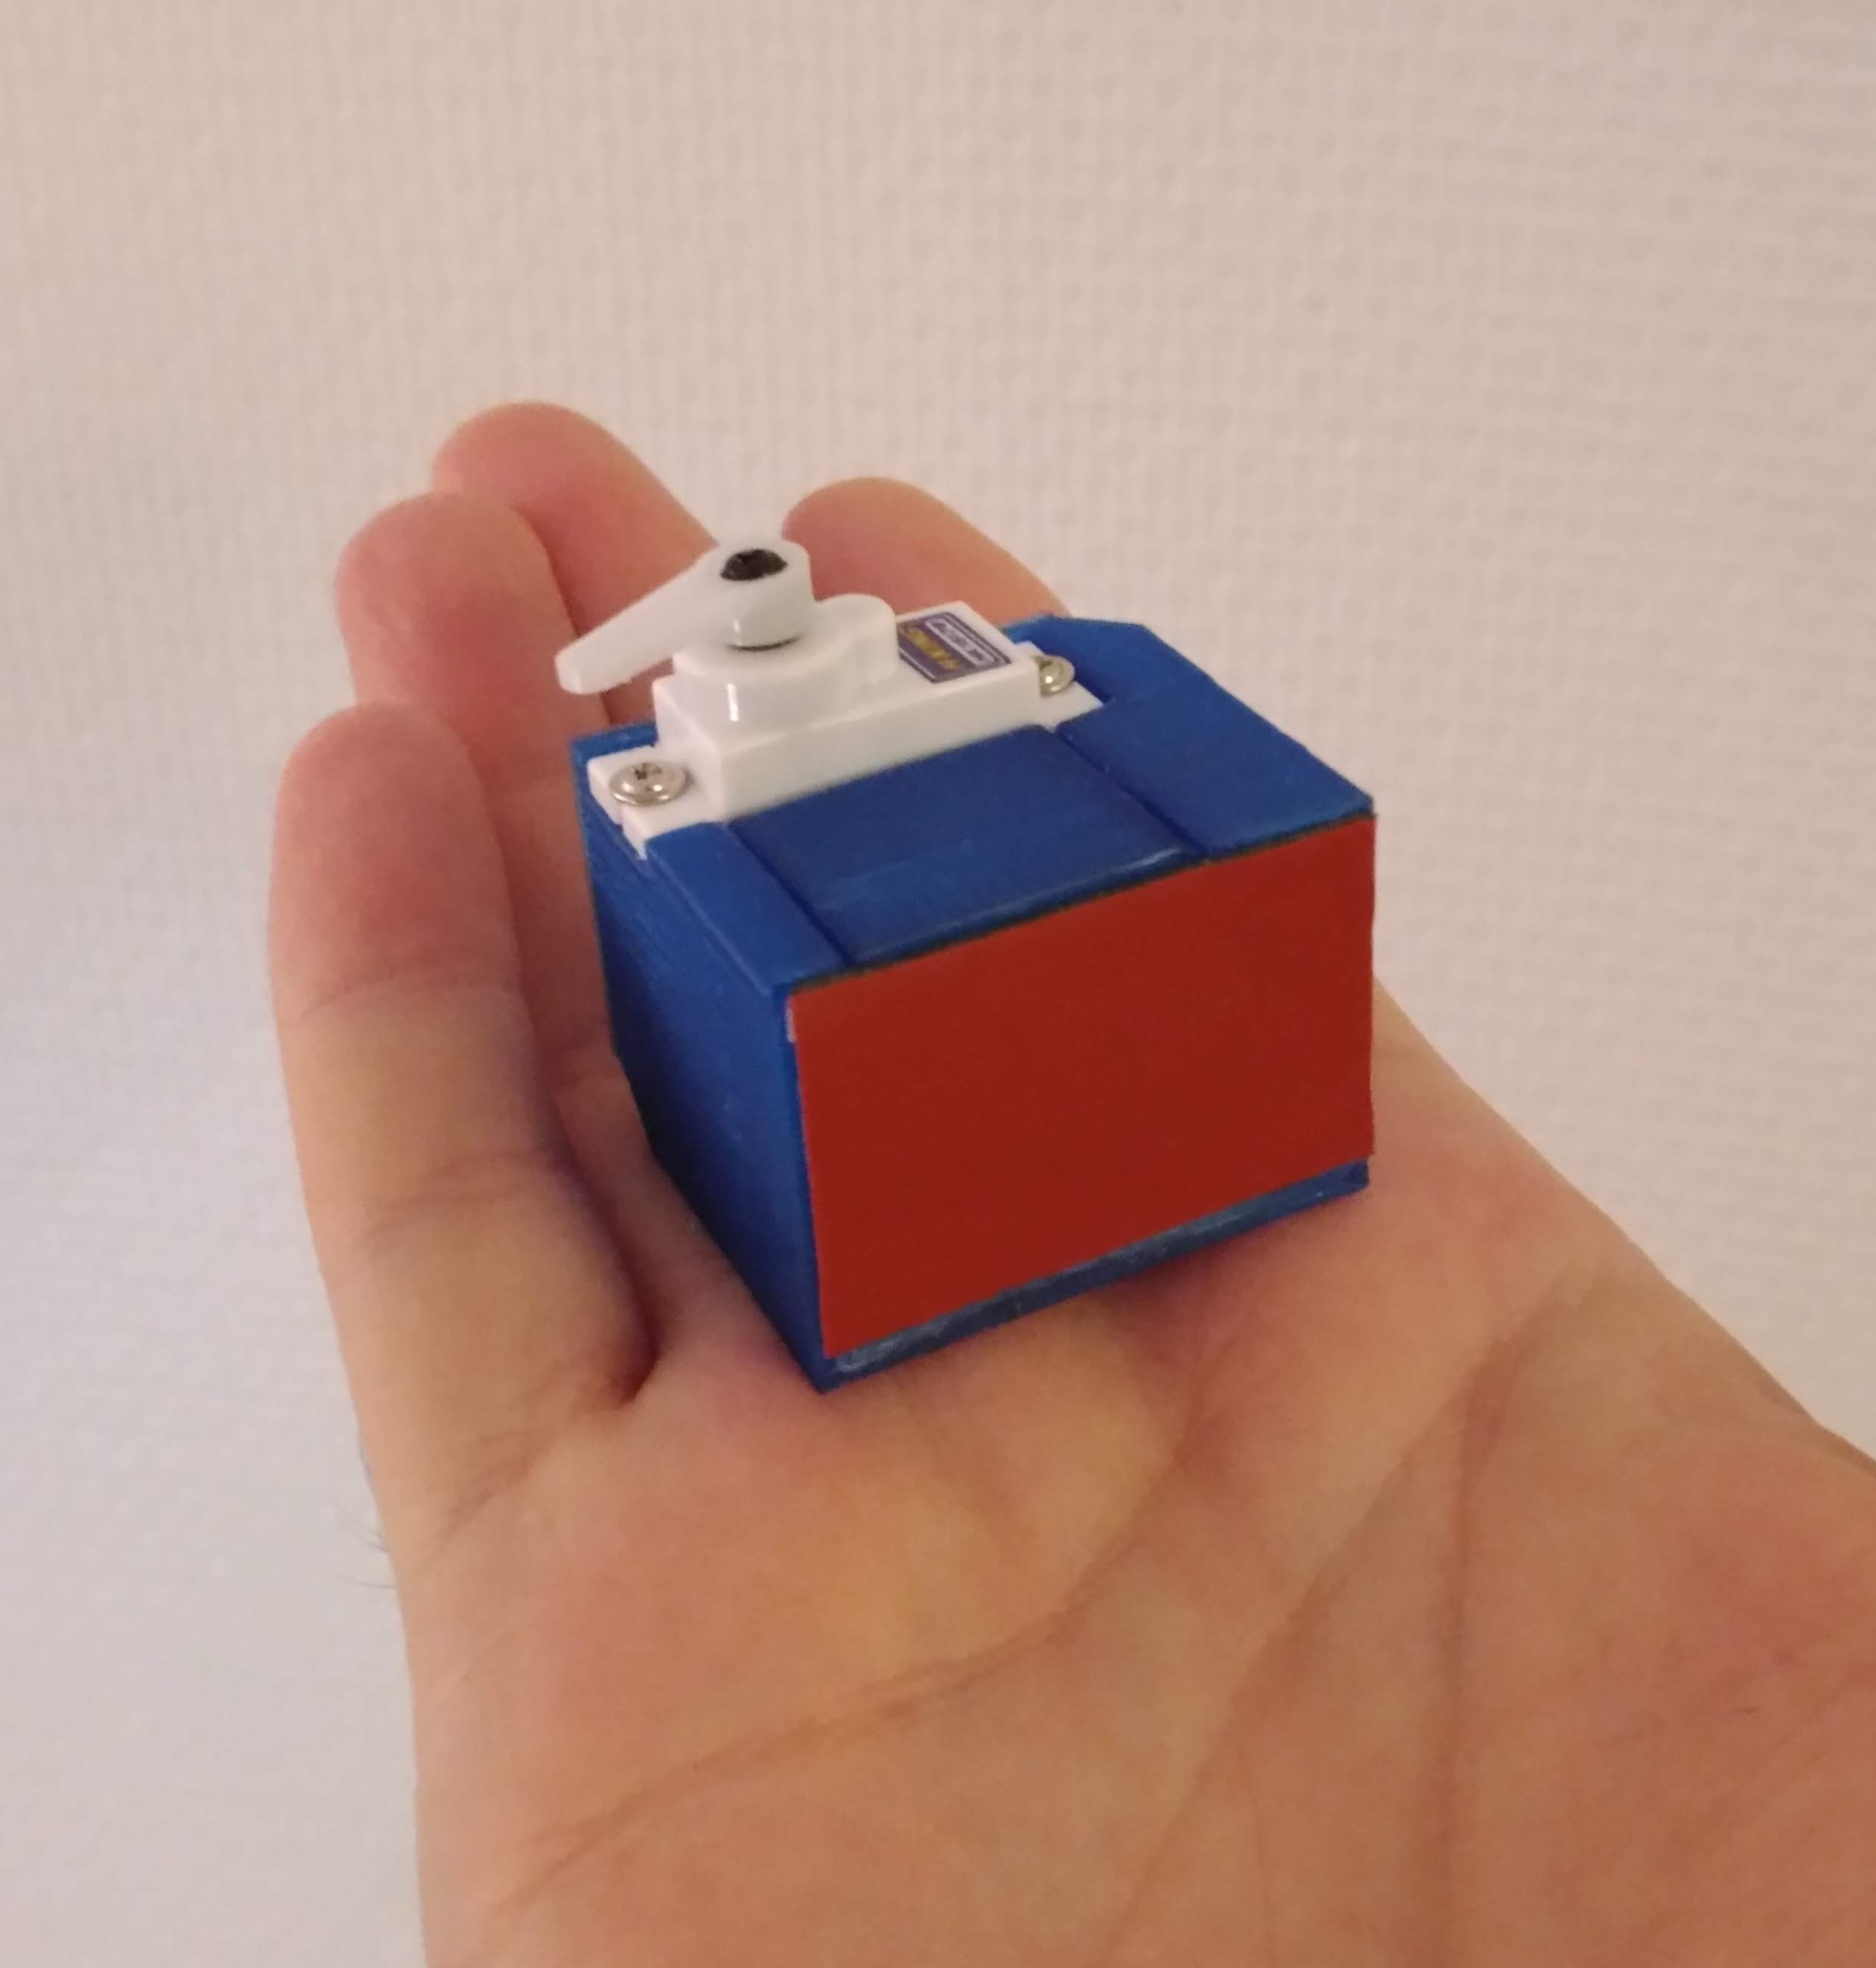
Solution

Slide 16
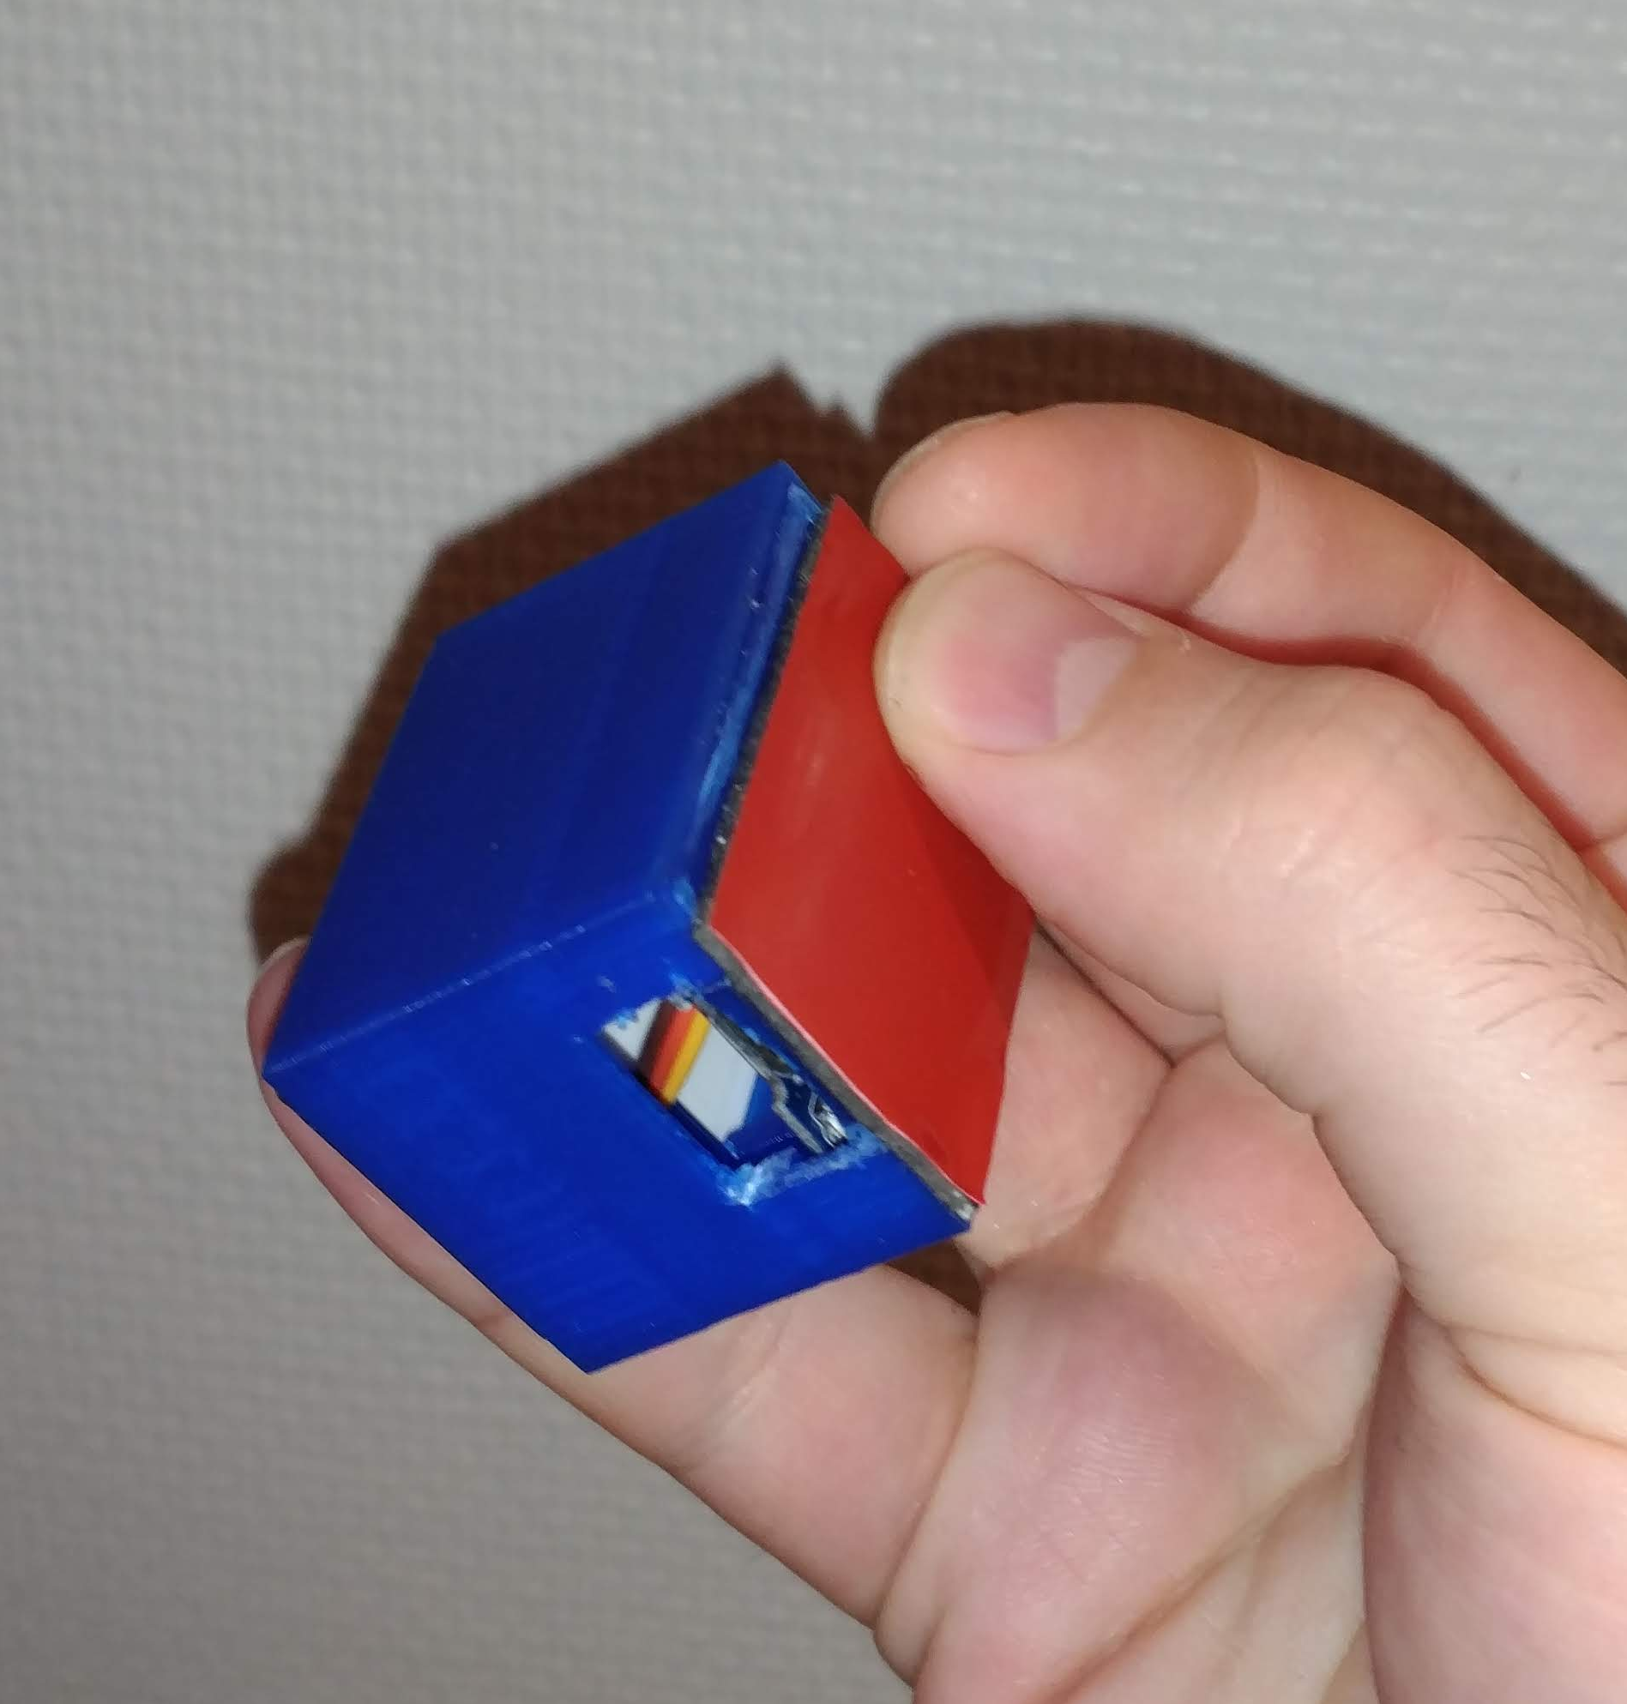
Solution

Slide 17
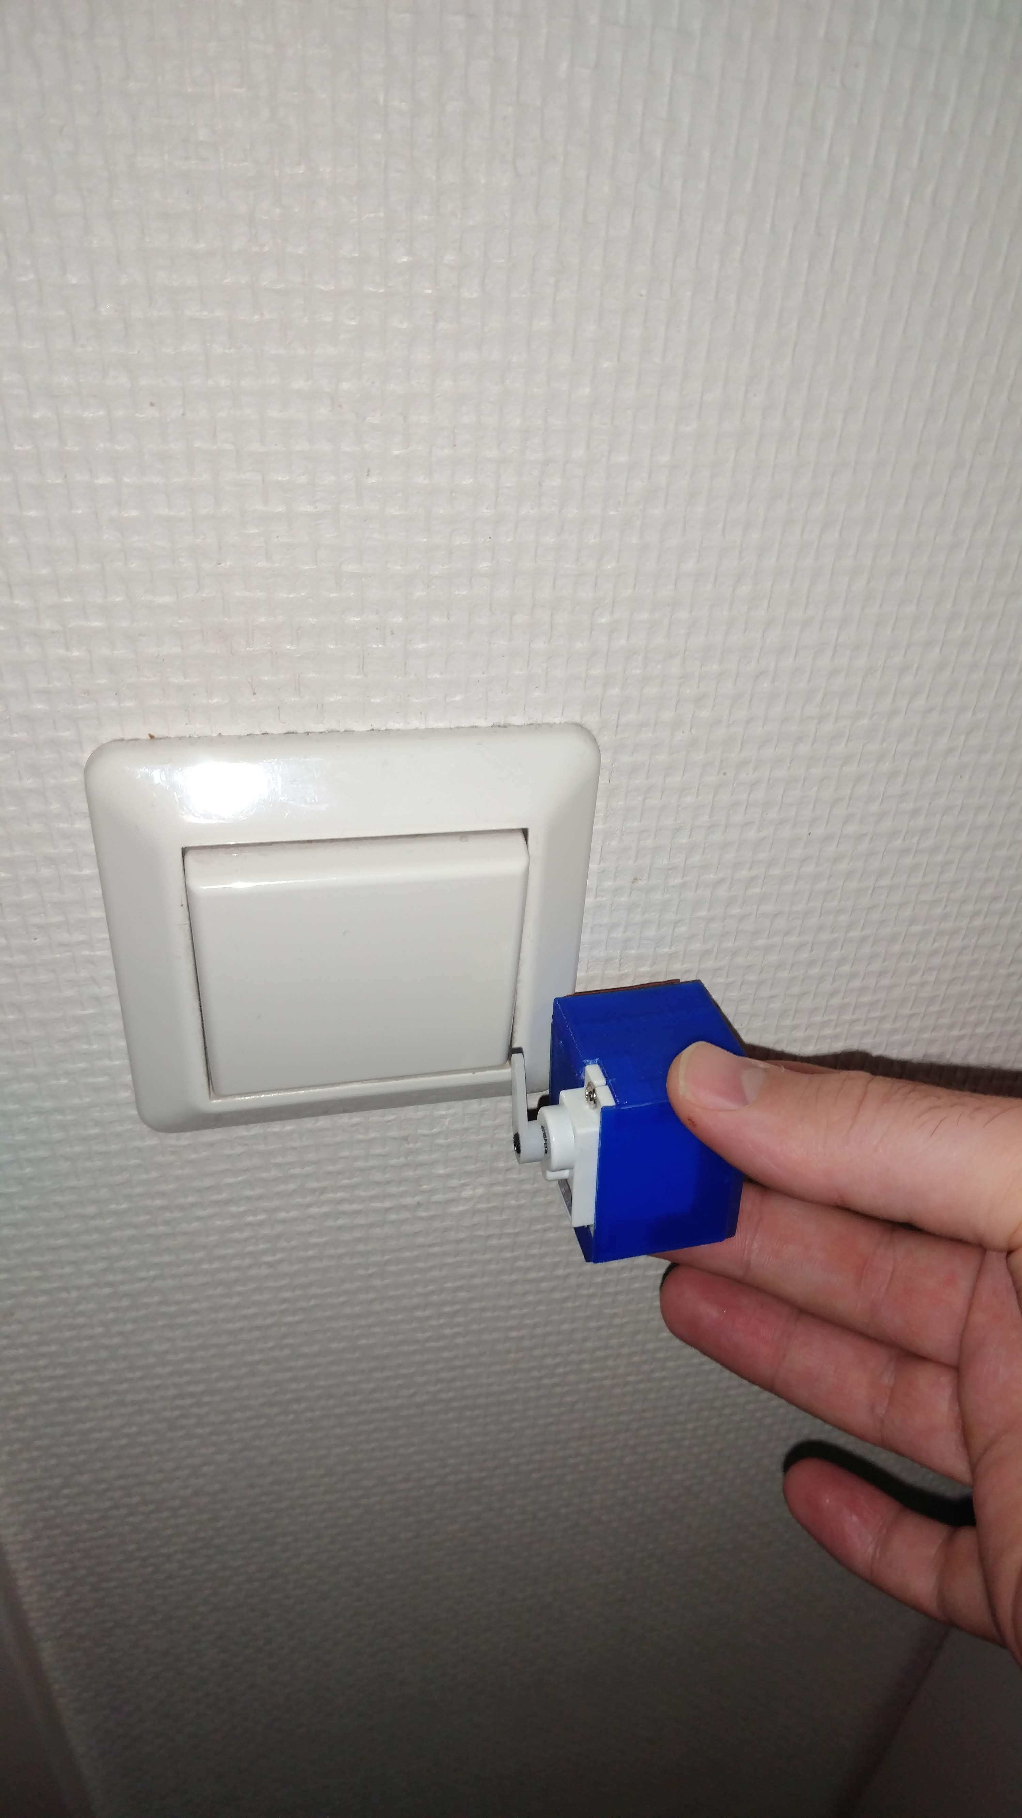
Solution

Slide 18





















IoTDualogCloud™

Slide 19
IoTDualogCloud™
19999
NOK

Slide 20
IoTDualogCloud™
9999 6999 4444 2962 1974 1316 877 584 389 259 172 114 76 50
39
NOK

Slide 21
IoTDualogCloud™
9999 6999 4444 2962 1974 1316 877 584 389 259 172 114 76 50
39
NOK
No additional monthly costs*

Slide 22
Experience EnterDualog
Notes:
I was late for exposing another idea, so this is my Project as a one man team

Slide 23
Experience EnterDualog
Vote = Early Access
Keyless future
Notes:
I was late for exposing another idea, so this is my Project as a one man team

